Slide 1

Distributed, Multi-Level Network Anomaly Detection for Datacentre Networks
Mircea Iordache, Simon Jouet, Angelos K. Marnerides, Dimitrios P. Pezaros
m.iordache-sica.1@research.glasgow.ac.uk
https://netlab.dcs.gla.ac.uk
School of
Computing Science

Slide 2
Distributed, Multi-Level Network Anomaly Detection for Datacentre Networks
Background & Motivation
Approach
Agg
ADS
ADS
ADS
Core
Notify
Agg
ADS
Agg
Edge
Edge
Edge
Edge
ADS
ADS
ADS
ADS
Edge
Edge
Edge
Edge
Edge
Edge
Edge
Edge
Rack
Rack
Rack
Rack
Rack
Rack
Rack
Rack
Rack
Rack
Rack
Rack
Results

Slide 3
Network Anomaly Detection Systems (ADS)
Network ADS are integral part of modern DC
  Ensure high-availability, many-9s SLAs, security
  Detect (and prevent) network anomalies
    Malicious: (D)DoS, Malware, Firewall, Exploits…
    Erroneous: Misconfiguration (network loops), faulty NIC…
Two common approaches:
  Signature-based: detect patterns in packet content or features. (SNORT, SURICATA)
  Statistics-based: detect deviations from normal network behaviour (Prelude IDS, ACID)

Slide 4
Deployment
Current approach
  Fixed point detection (limited network knowledge)
  Little (if any) state sharing
New Philosophy
  Move detection closer to Edge Switches and Rack
  Increase communication between multiple ADS
ADS
Core
ADS
ADS
Agg
Agg
Edge
Edge
Edge
Edge
Edge
Edge
Edge
Edge
Rack
Rack
Rack
Rack
Rack
Rack
Rack
Rack

Slide 5
Proposed Architecture
Move detection to Edge
  Propagate up to the Core for higher accuracy
    Source pinpointing for efficient mitigation
  Share partial knowledge via voting
Modular components
  Focus on small tasks
  Run on Network Nodes (switches, routers)
  Flexible mapping to the Network Fabric
    Scale of deployment based on network demand
Leverage SDN
  Inform Controller of any issues
  Let Controller handle mitigation strategy
Core
Agg
Agg
Edge
Edge
Edge
Edge
Edge
Edge
Edge
Edge
ADS
ADS
ADS
ADS
ADS
ADS
ADS
ADS
Rack
Rack
Rack
Rack
Rack
Rack
Rack
Rack

Slide 6
Communication Model
Core
Notify Upstream
Confirm Anomaly
Agg
Agg
Agg
ADS
Anomaly Detected
Edge
Edge
Edge
Edge
Edge
Edge
Edge
Edge
ADS
ADS
ADS
ADS
ADS
ADS
ADS
ADS
ADS
Rack
Rack
Rack
Rack
Rack
Rack
Rack
Rack

Slide 7
Path Reconstruction
Create a tree structure of involved ADS modules
  Based on Notification tracing
  Can pinpoint source or convergence point
    Efficient mitigation, reduce congestion
Can use controller for strategic decisions
  Most likely paths, source(s)

Slide 8
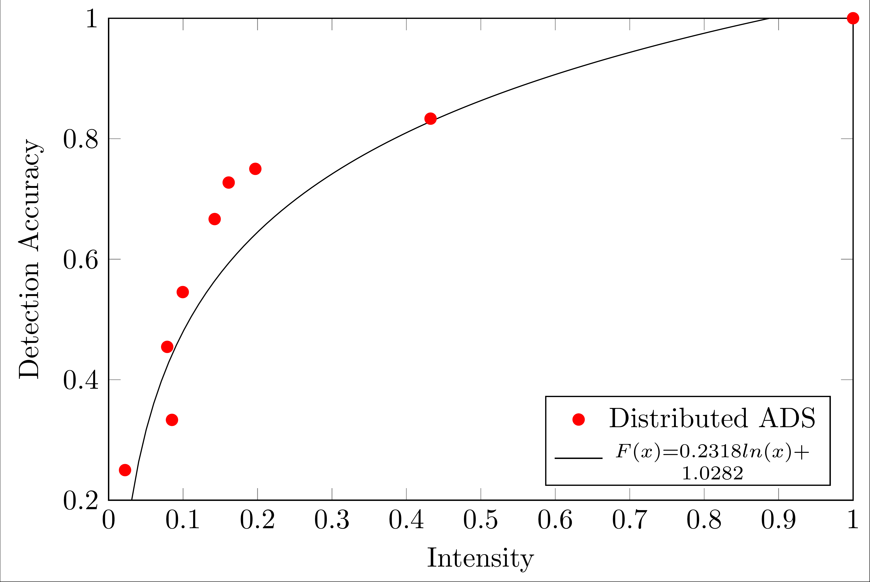
Detection Accuracy

Slide 9
Path Reconstruction Capabilities

Slide 10
Bandwidth Saving From Pinpointing

Slide 11
Questions?
Mircea Iordache
m.iordache-sica.1@research.gla.ac.uk

