Slide 1

On the Optimality of Virtualized Security Function Placement in Multi-Tenant Data Centers
Abeer Ali, Dimitrios Pezaros, Christos Anagnostopoulos
School of Computing Science, University of Glasgow
IEEE ICC'18 @ Kansas City, United States

Slide 2
Outline
Background
Proposed system
ILP formalization
Evaluation

Slide 3
Network Security Systems
Fixed allocation
Centralized & Monolithic systems
Limited extent of functionality
Expensive
Vendor lock-in
Software-based Middleboxes ​
Hardware-based Middleboxes
Rapid and Flexible deployment
Allow extension of functionality
Inexpensive compared to HW
No Vendor lock-in
Scalable resources
SDN and VNF
Security Services in Amazon’s AWS Multitenant virtualized infrastructures
  (2015) Firewall web application(WAF)
  Dec 2016 AWS Shield (DDoS protection services)
  Nov 2017 GuardDuty (Intelligent threat detection)

Slide 4
Management of Virtualized security services in Multitenant infrastructure
Provided and managed by the infrastructure provider
  Services allow user access for customizing and tuning
  Services are allocated, deployed and monitored by the infrastructure provider
  Target efficient management of the infrastructure resources to max. profit
We propose an allocation strategy for virtualized security services on the network Infrastructure
  Provide customized security services in multitenant infrastructures against outsider attacks
  Efficient management of the infrastructure resources
Notes:
Not only apply to security but all services

Slide 5
Proposed system
VM Placement, Softwarized middleboxes or VNF placement
Proposed approach
  Designed for Security NF
    Special constraints of security functions
  Deployment locations is collected with the network switches
    Minimize the overhead caused by the functions and maintain efficient management of the infrastructure resources
  Distributed approach (if possible)
    Many related work maintained the centralized, monolithic deployment of hardware middleboxes

Slide 6
Security Functions Equivalence Classes
Stateless
Firewalls
Examples: ZoneAlarm, Snort, Suricata
Stateful
Anomaly based IDS,IPS
Examples: Change_point Detection, Entropy and Classifiers
Signature based (IDS)
Deep packet Inspection(DPI)
Duplicated instances
Single instance
Allocation

Slide 7
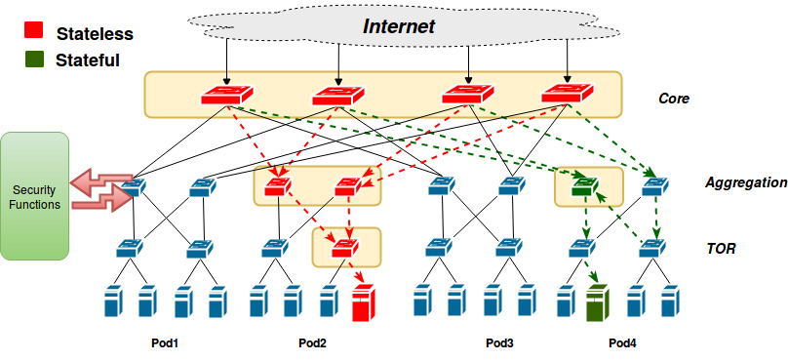
Implementation
Allocation of the two equivalence classes in k=4 fat-tree datacentre
We implement the Placement as an optimization problem
Two objectives
  Max Resources Allocation ratio
  Max Residual Resources
Notes:
careful here: does the optimization funciton really have two objectives, or does the one follow from the other?

Slide 8
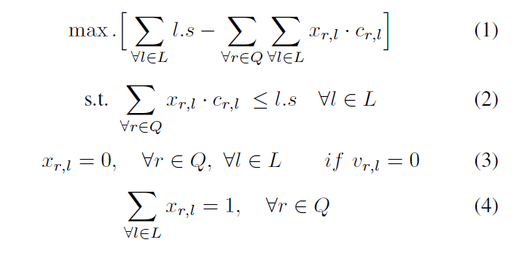
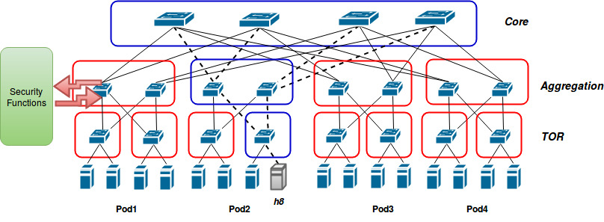
Resource-Aware Static Placement
Instance of variable size variable cost bin packing problem
    No polynomial time solution
Modeled as ILP problem
  Objective is to Max Residual Resources

Slide 9
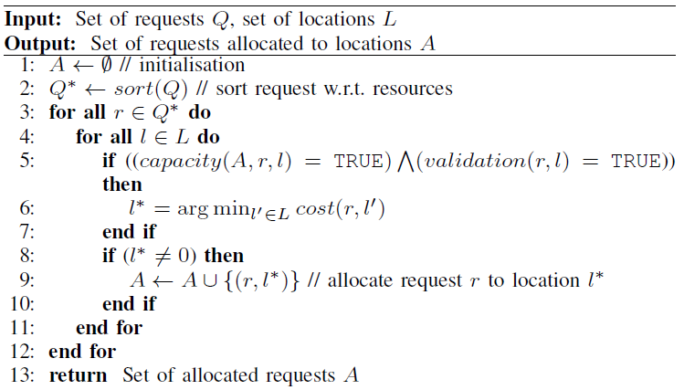
Greedy algorithm
Best Fit Decreasing (BFD) algorithm for security functions
  Polynomial time solution
    Functions requested are sorted in a decreasing order based on resource consumption
    Allocated to best fit location
      Location which results in the least increase in resource consumption.

Slide 10
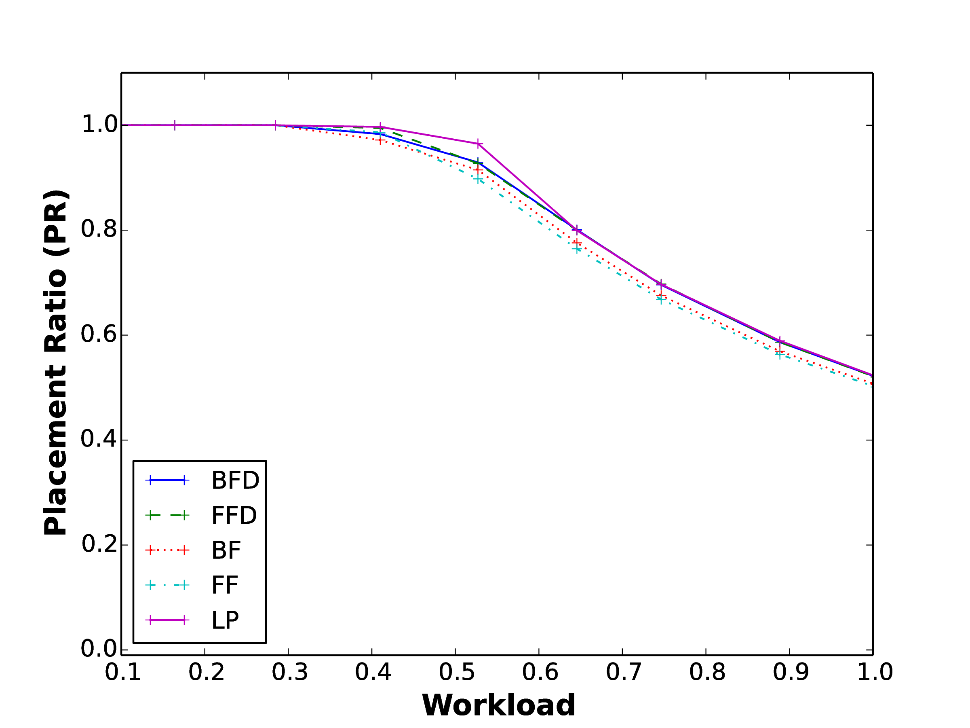
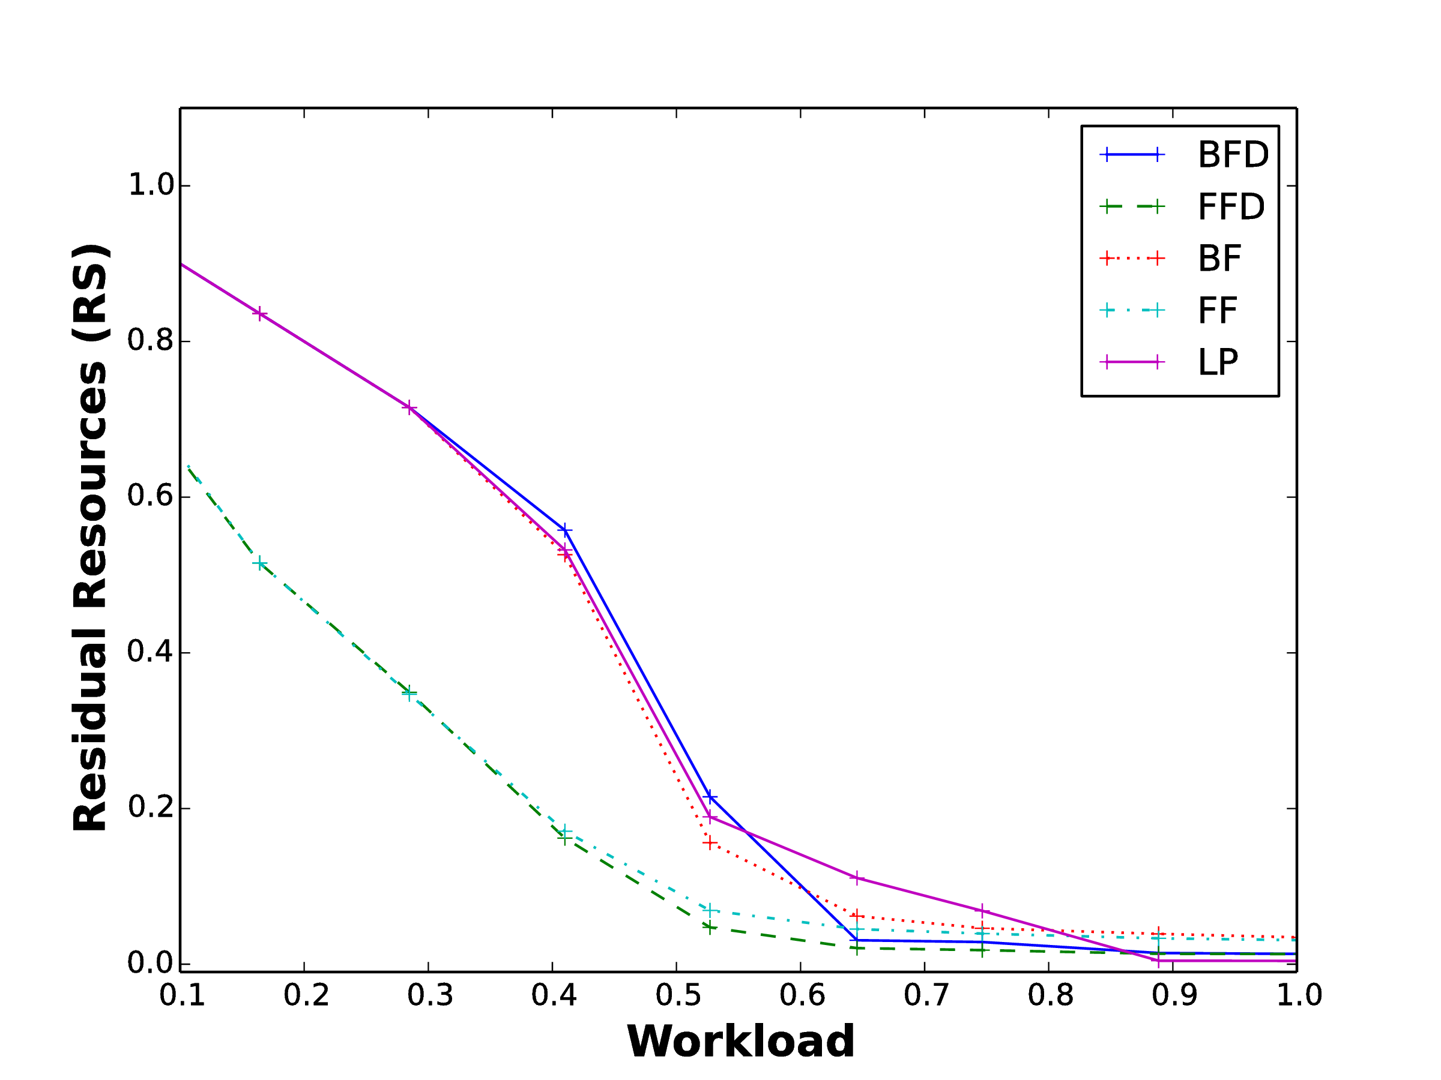
Evaluation
Placement Ratio
(PR)
Residual Resources (RS)
K=8 p=20
Notes:
Simulator

Slide 11
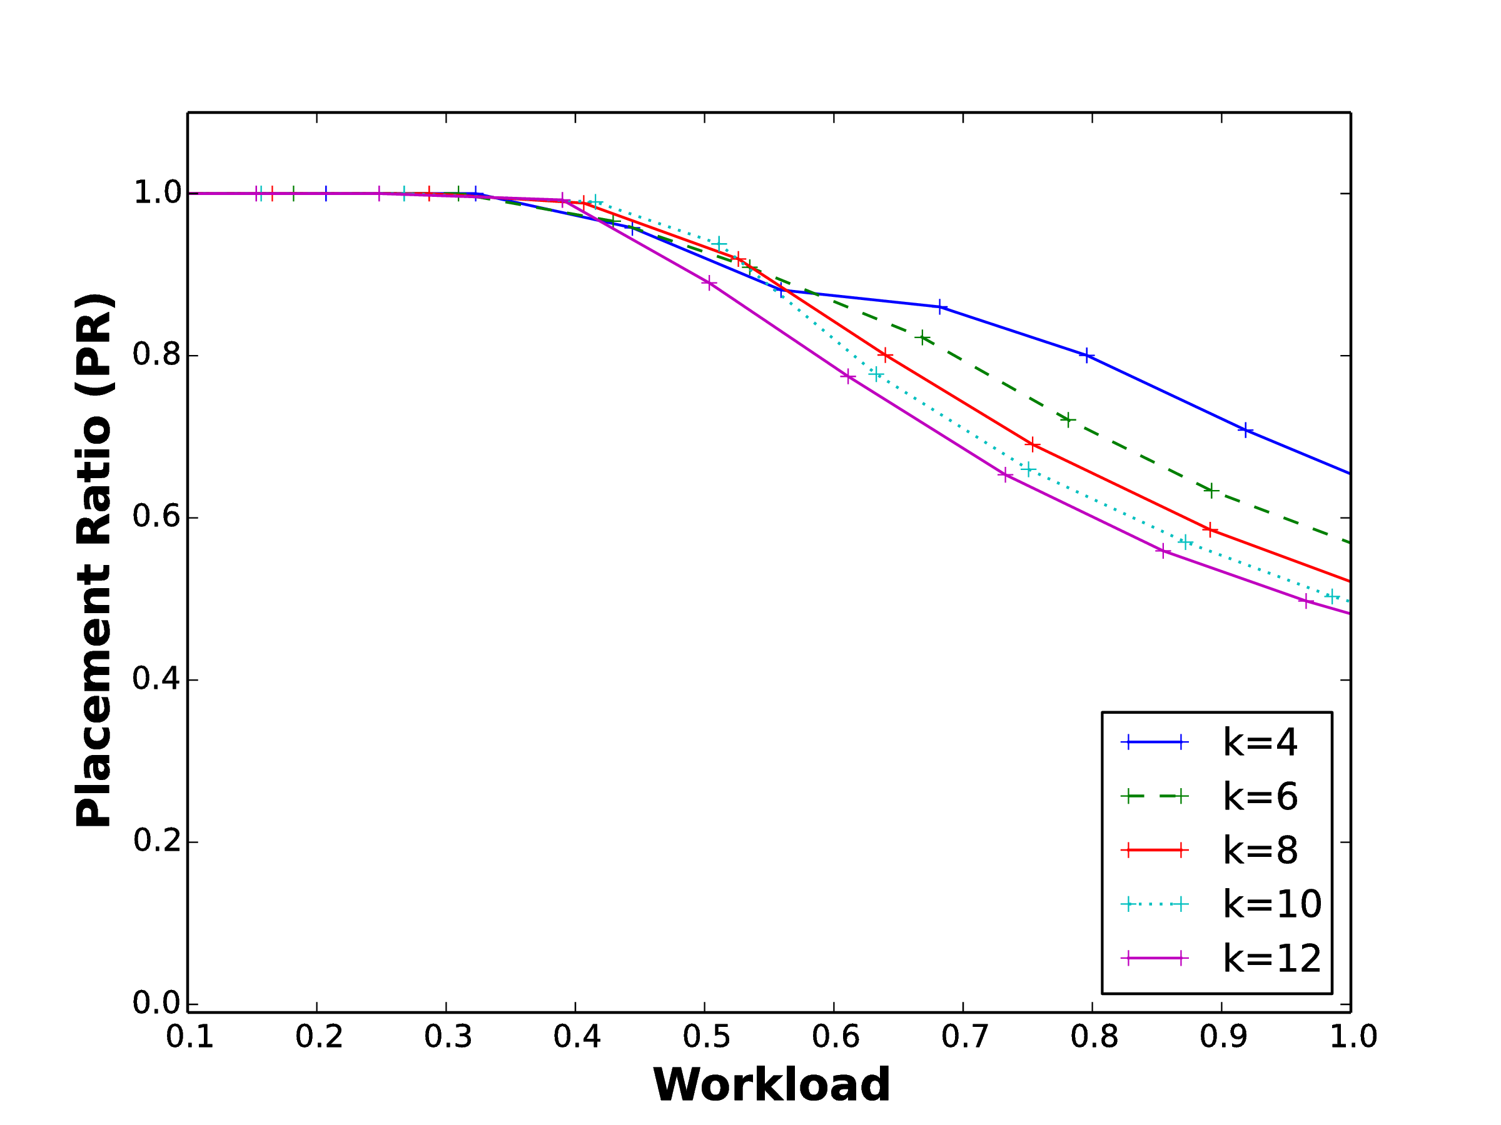
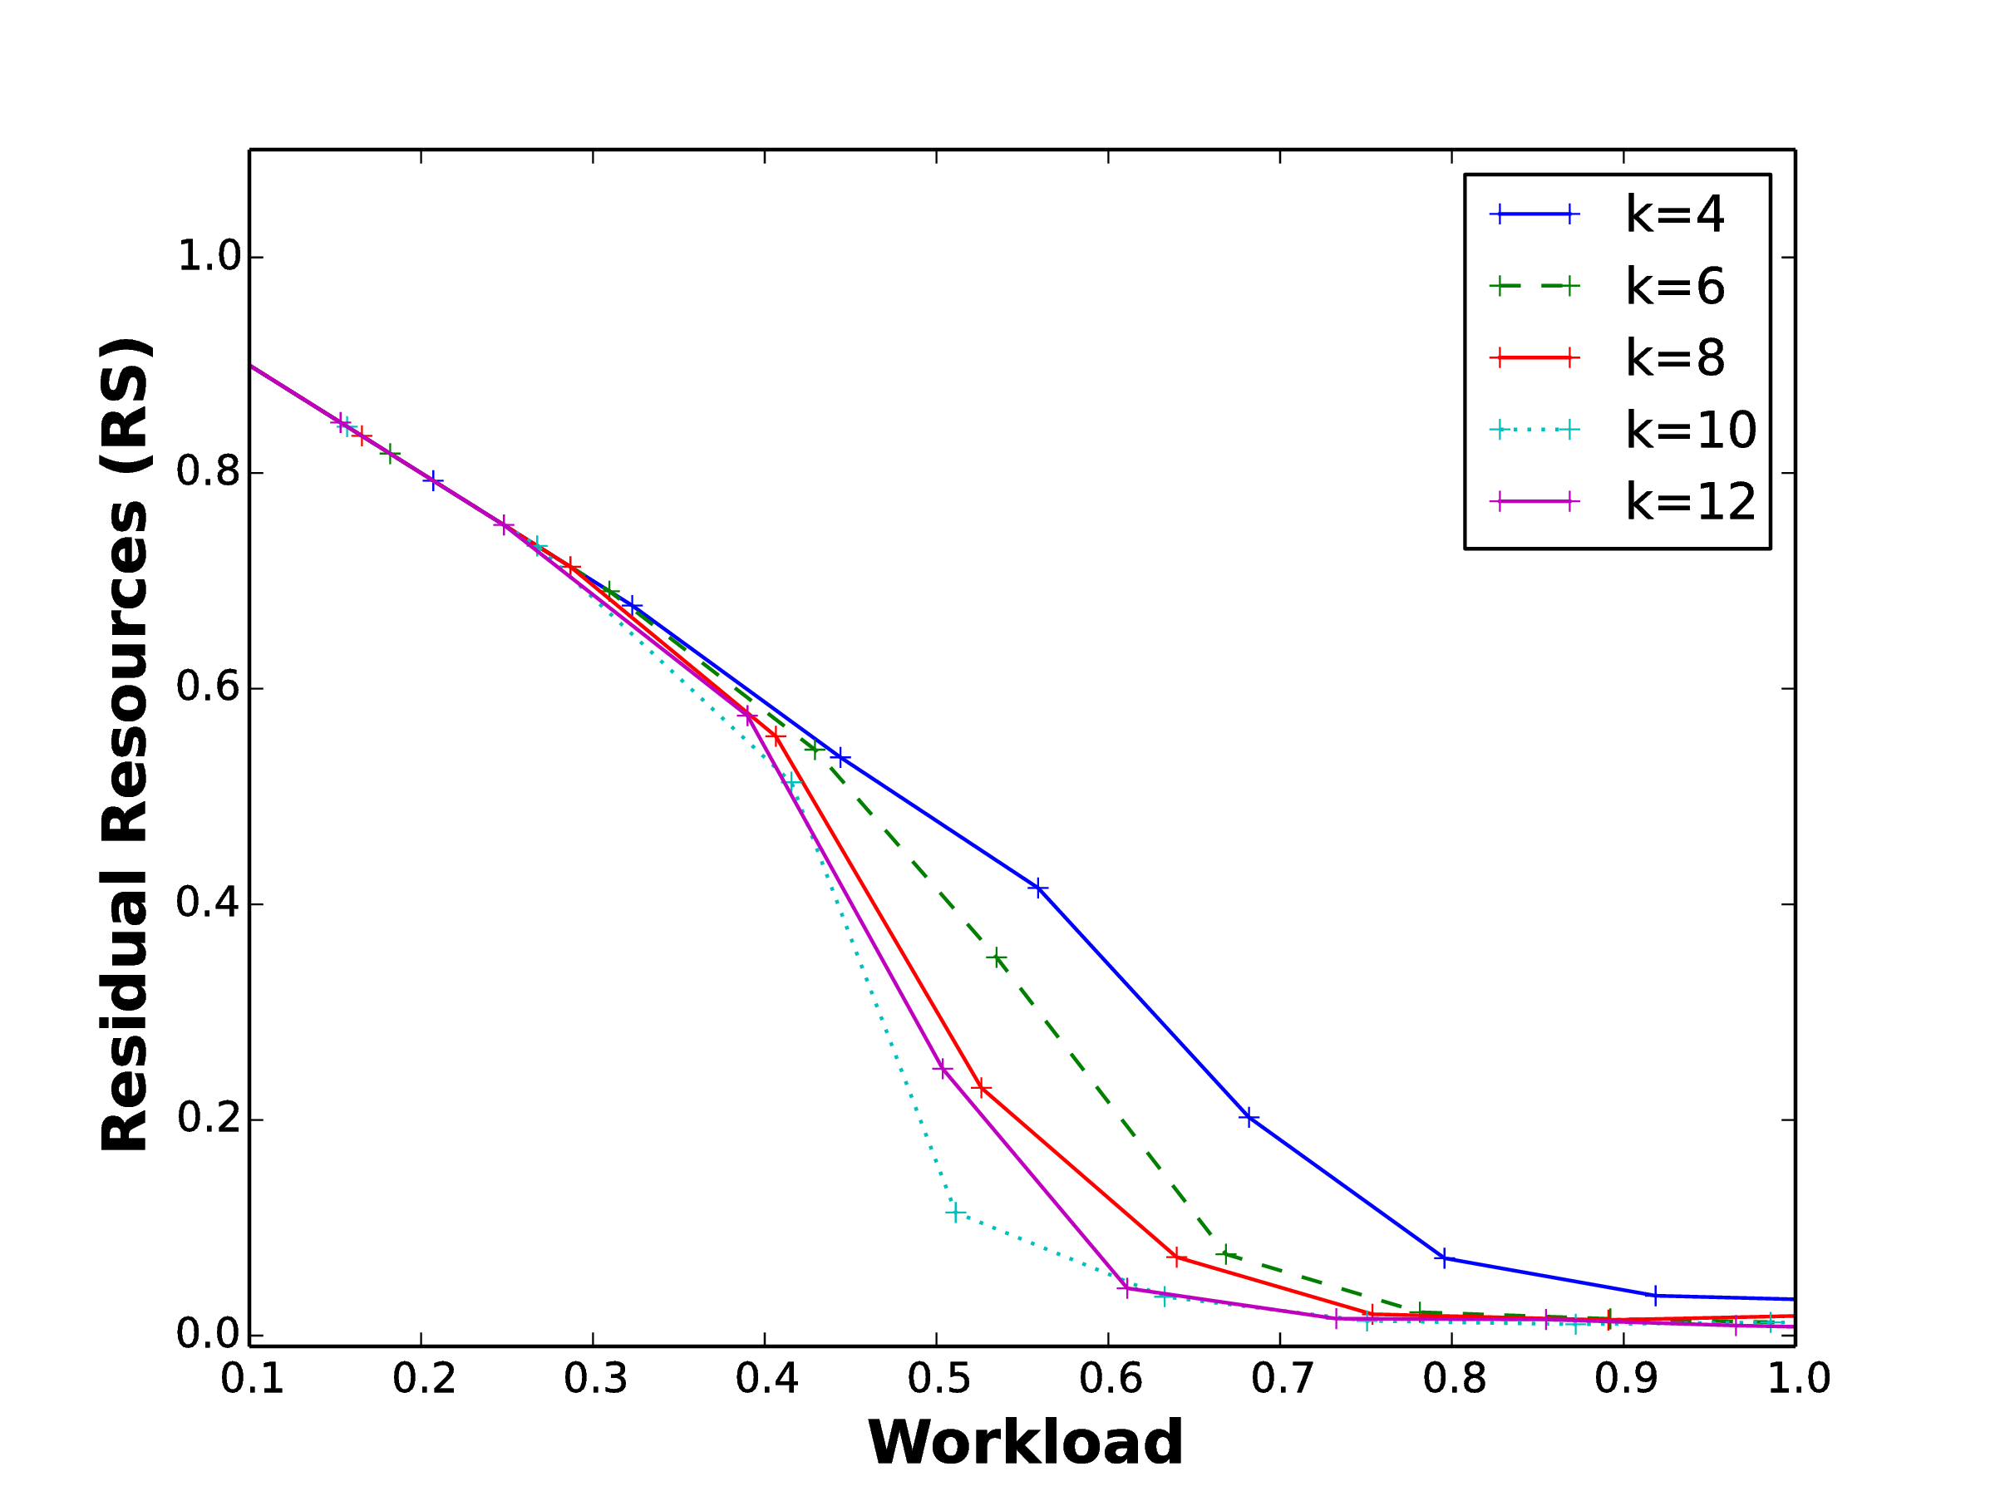
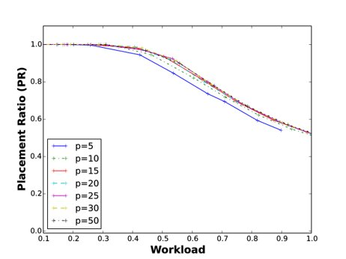
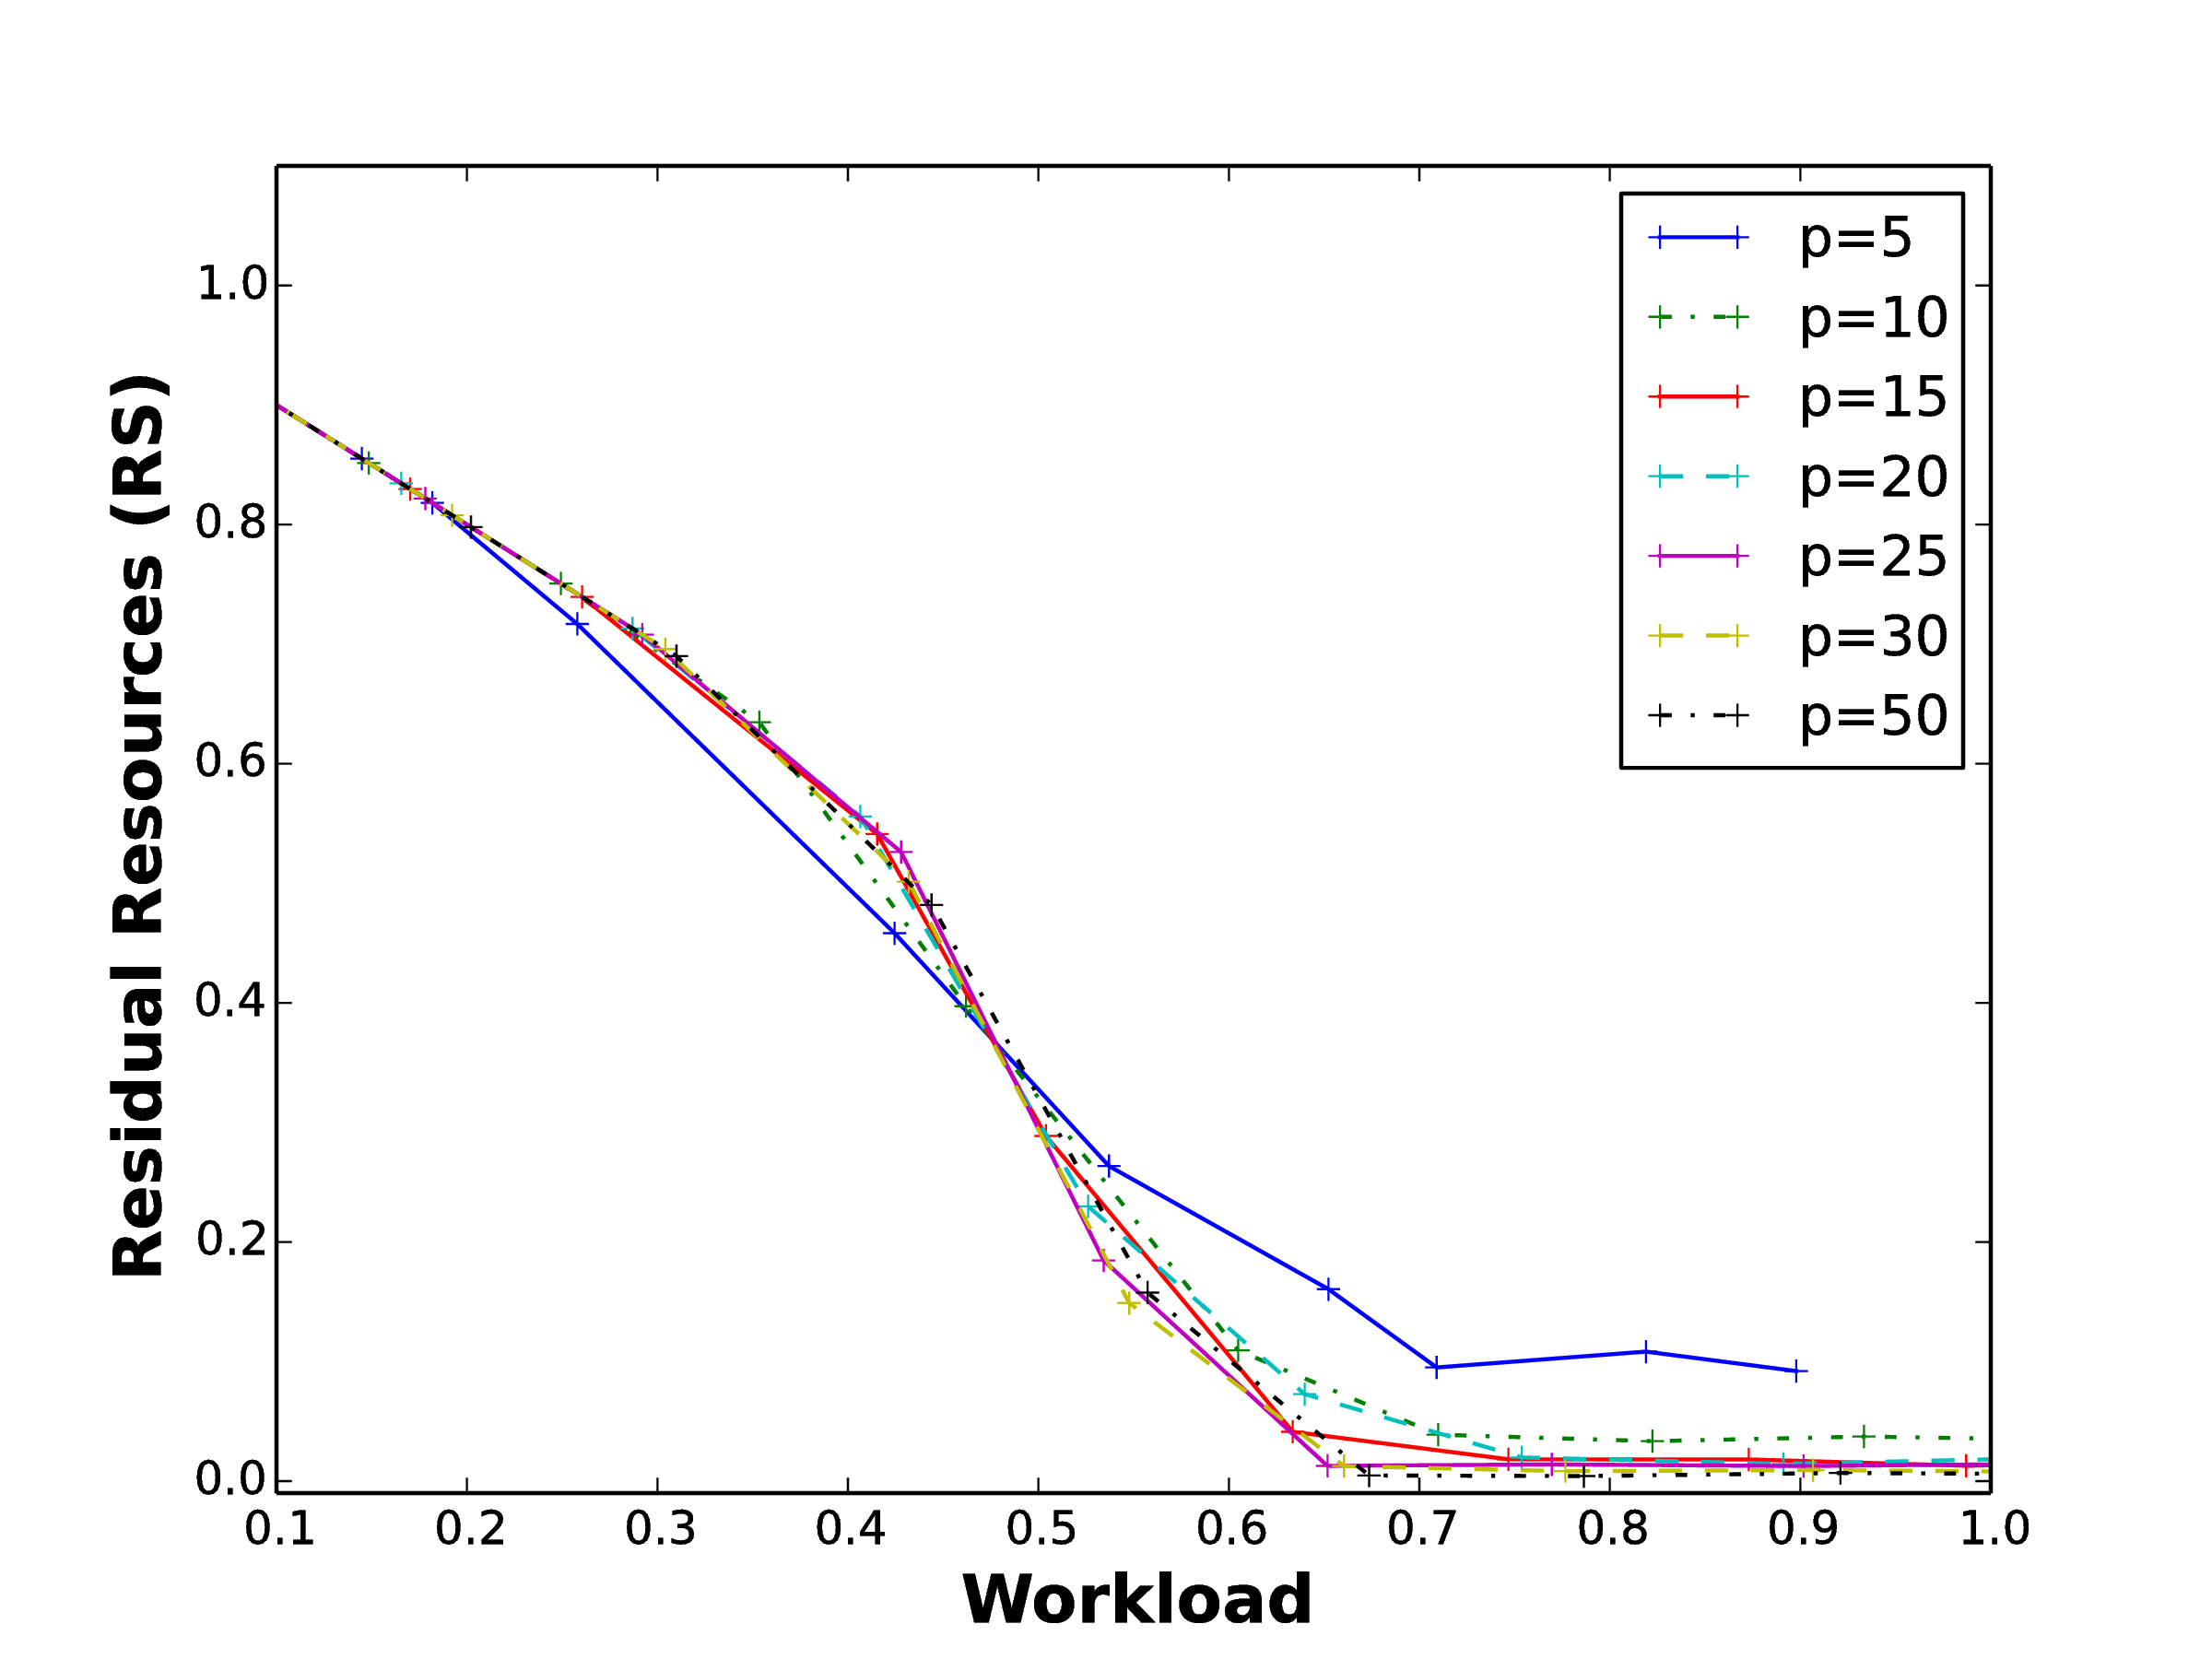
Scalability of BFD Algorithm
K=4,6,8,10 and 12 ,p=20
p=5,10,15,20,25,30 and 50
Placement Ratio (PR)
Residual Resources (RS)

Slide 12
  Thank you.
  https://netlab.dcs.gla.ac.uk/

