Slide 1


Quality-aware Aggregation & Predictive Analytics at the Edge
EU/H2020 GNFUV
Natascha Harth & Christos Anagnostopoulos
School of computing science
University of Glasgow, scotland
IEEE International Conference on Big Data ; 11-14 DEC 2017, Boston, MA, USA

Slide 2
Agenda
Introduction
Experiments
Evaluation
Methodology
Results

Slide 3

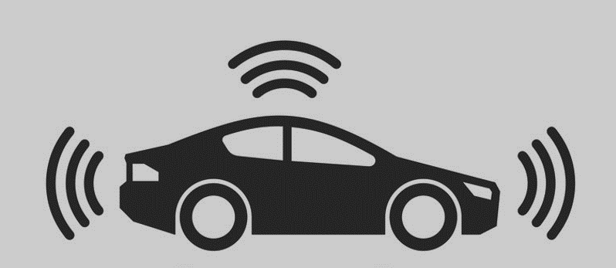


Context
Cloud
Sensing & Actuator Devices
IoT Gateways (Edge/Fog Network)
Cloud Environments
Introduction

Slide 4
Constraints at the Edge
Limited Bandwidth…
Energy
Limited Computational Power
Storage Capacity
Latency!
Idea: Observe your Power & Push
Exploit the limited computational power of sensing & actuator devices
Push Intelligence to the Edge:
  inferential tasks, on-line statistical learning, classification, localized detection,…are pushed at the Edge
Introduction

Slide 5
Hypotheses & Actions
  Given the constraints of an IoT network, let us hypothesise the following actions:
  Action 1: Reduce the communication overhead
    Hypothesis 1: not all data are needed for inferential tasks/regression, i.e., Learn More With Less!
  Action 2: Perform real-time predictive analytics for instant action & autonomous decision making
    Hypothesis 2: use the limited computational power to infer and take decisions in an On-Line Manner!
  Action 3: Provide high quality predictive analytics tasks (e.g., prediction accuracy, model fitting)
    Hypothesis 3: decide which is the best data to learn and when to learn, i.e., Be Intelligent On What You See!
Introduction

Slide 6
Challenges & Problem Definition
  Decide which data to communicate without losing quality of data & analytics
  Problem 1: time-optimized data selection problem.
  Decide when to deliver/send data and what to send in light of maximizing the predictive analytics accuracy
  Problem 2: time-optimized delivery scheduling problem.
  Reduce unnecessary communication between/among devices and/or the Cloud
  Problem 3: conditionally data forwarding problem.
Introduction

Slide 7
Contribution
  Introduce an optimal, quality-aware, and on-line decision making model determining when and which data to deliver within the Edge Network.
  Maximize the quality of analytics tasks s.t. being communication efficient.
  Domain: Aggregation & Linear Regression Analytics over Sliding-Window Contextual Data Streams.
Introduction

Slide 8

SAN₁
Context Vector
$$x_{t}=[x_{1t},…,x_{dt}]$$
SAN₂
Sliding Window per SAN
SAN₁
$$x_{t}$$ | $$x_{t−1}$$ | $$x_{t−2}$$ | $$…$$ | $$x_{t−N}$$
SAN₃
EN_{j}
...
SAN₄
SAN_{i}
$$x_{t}$$ | $$x_{t−1}$$ | $$x_{t−2}$$ | $$…$$ | $$x_{t−N}$$
SAN_{i}
Sensor & Actuator Node
Edge Node (IoT Gateway)
Methodology

Slide 9

Idea: Predict, Decide & Reconstruct
Step 1: Local Prediction at SAN (Sensor & Actuator Node)
  $${\hat{x}}_{t}=f\left(x_{t−1},…,x_{t−N}\right)=f_{i}(𝒲)$$
  $$e_{t}=d^{−\frac{1}{2}}\left\|x_{t}{−\hat{x}}_{t}\right\|$$
Step 2: Local Re-Construction at EN (Edge Node)
  $${\tilde{x}}_{t}=g\left(u_{t−1},…,u_{t−M}\right)=g_{j}(𝒲)$$
Methodology

Slide 10

Instantaneous Decision Making (IDM)
SAN employs locally selective forwarding: deliver data if current prediction error > threshold (θ)
Naïve Goal: Reduce communication overhead; but no focus on the Quality of Analytics
Major Issues:
  What if θ is relatively high (no control on the analytics quality)
  What if the prediction function in SAN is too good (never sends data!)
  What if Outliers occur (sends only outliers!)
  → information loss at the EN.
$${e }_{t}≥θ$$
SAN_{i}
EN_{j}
Methodology

Slide 11
Observation: Very good prediction at SAN ☺
Consequence: EN cannot reconstruct data stream ☹
Observation: Outliers/Novelty data at SAN!
Consequence: EN receives only novelty/outliers ☹
Methodology

Slide 12
Optimal Stopping Theory (Which & When)
Problem: IDM is not capturing the variability of the data stream inside EN…
Major Goal: Send high quality of information in the right moment, in other words: which data and when to send.
Solution: Develop an Optimal Stopping Time stochastic model to find the optimal forwarding time at SAN such that maximises the expected analytics quality at the EN.
Idea: Instead of sending every time θ exceeds prediction error, we find the best time and context vector to send:
  we optimally delay data delivery thus being communication efficient;
  we accumulate the prediction error history of IDM decisions thus controlling the analytics accuracy.
Methodology

Slide 13
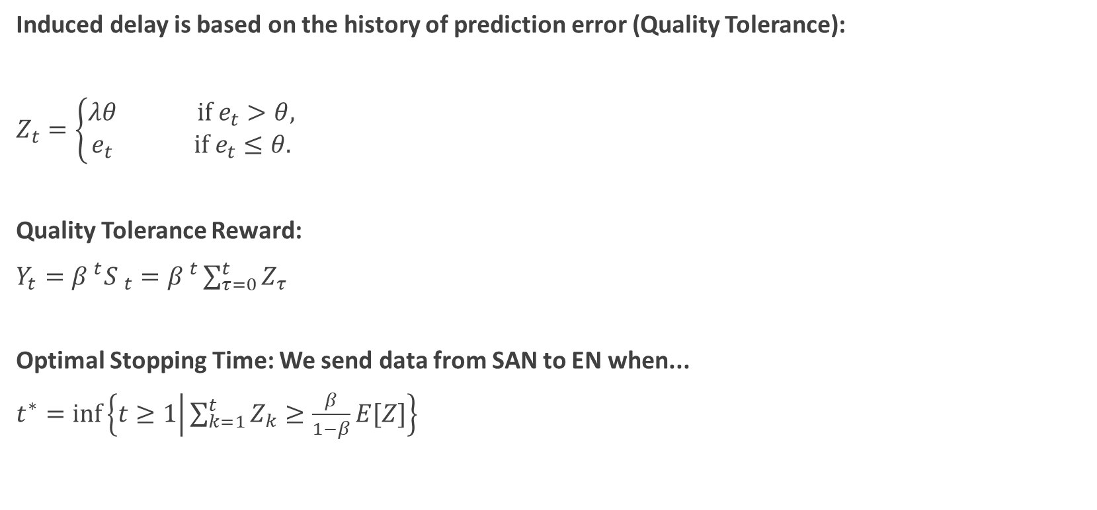
Optimal Vector Forwarding (OVF)
Induced delay is based on the history of prediction error (Quality Tolerance):
$Z_{t}=\left\{\begin{matrix}λθ if e_{t}>θ, \\ e_{t} if e_{t}≤θ.\end{matrix}\right.$
Quality Tolerance Reward:
$Y_{t}={β }^{t}{S }_{t}={β }^{t}\sum_{τ=0}^{t}{Z_{τ}}$
Optimal Stopping Time: We send data from SAN to EN when...
$t^{∗}=inf\left\{t≥1 | \sum_{k=1}^{t}{Z_{k}≥\frac{β}{1−β}E[Z]}\right\}$
Monitor: Accumulation of Local Prediction Errors
Tolerate: Do not send & accumulate prediction errors
Minimize communication overhead
s.t. maximizing quality tolerance
Methodology

Slide 14
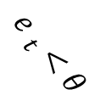
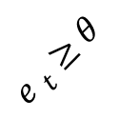
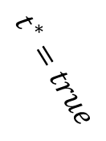
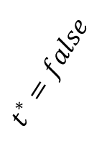
Hybrid Optimal Vector Forwarding (HOVF)
Combines IDM and OVF methodology
$${e }_{t}≥θ$$
$${e }_{t}<θ$$
SAN sends to EN
(novelty)
$$t^{∗}=true$$
$$t^{∗}=false$$
SAN does not send to EN
(tolerance)
SAN sends to EN
(best data and the best time)
Methodology

Slide 15
Methodologies
Baseline: Sending continuously data from Edge to Cloud!
Instantaneous Decision Making (IDM): prediction-error based decision
Optimal Vector Forwarding (OVF): quality-tolerance based decision
Hybrid Optimal Vector Forwarding (HOVF): intelligence is now pushed at SANs
Methodology

Slide 16
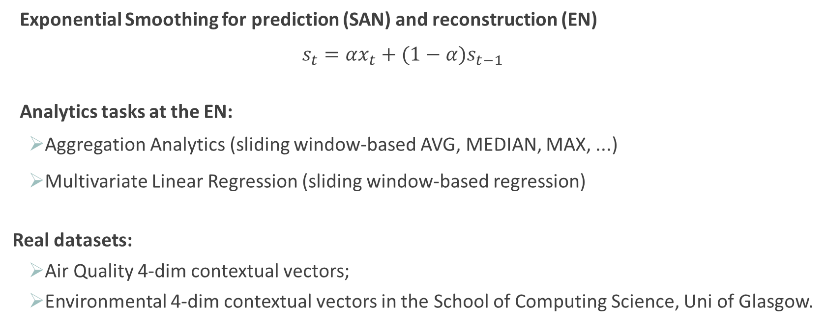
Experiments
Exponential Smoothing for prediction (SAN) and reconstruction (EN)
    $$s_{t}=αx_{t}+(1−α)s_{t−1}$$
Analytics tasks at the EN:
  Aggregation Analytics (sliding window-based AVG, MEDIAN, MAX, ...)
  Multivariate Linear Regression (sliding window-based regression)
Real datasets:
  Air Quality 4-dim contextual vectors;
  Environmental 4-dim contextual vectors in the School of Computing Science, Uni of Glasgow.
Experiments

Slide 17
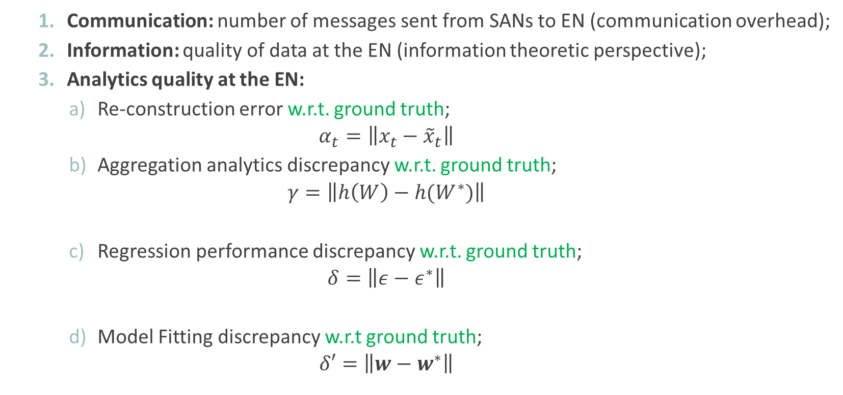
Evaluation: Three Directions
  Communication: number of messages sent from SANs to EN (communication overhead);
  Information: quality of data at the EN (information theoretic perspective);
  Analytics quality at the EN:
      Re-construction error w.r.t. ground truth;
      $$α_{t}=\left\|x_{t}−{\tilde{x}}_{t}\right\|$$
      Aggregation analytics discrepancy w.r.t. ground truth;
      $$γ=\left\|h\left(W\right)−h(W^{∗})\right\|$$
      Regression performance discrepancy w.r.t. ground truth;
      $$δ=\left\|ε−ε^{∗}\right\|$$
      Model Fitting discrepancy w.r.t ground truth;
      $$δ′=\left\|w−w^{∗}\right\|$$
Evaluation

Slide 18
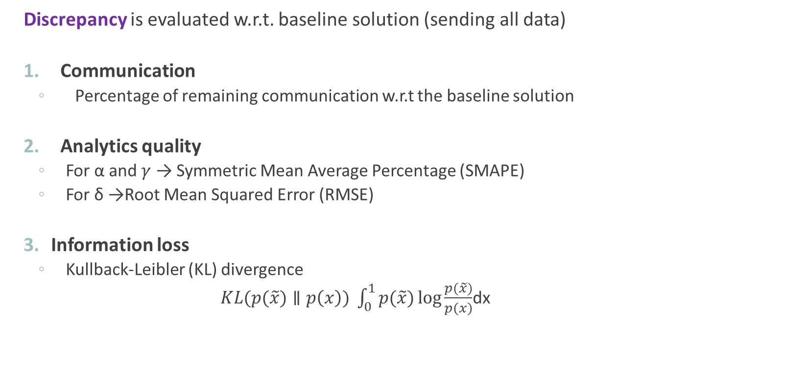
Metrics
  Discrepancy is evaluated w.r.t. baseline solution (sending all data)
  Communication
    Percentage of remaining communication w.r.t the baseline solution
  Analytics quality
    For α and $γ$ → Symmetric Mean Average Percentage (SMAPE)
    For δ →Root Mean Squared Error (RMSE)
  Information loss
    Kullback-Leibler (KL) divergence
            $KL(p(\tilde{x})∥p\left(x\right)) \int_{0}^{1}{p(\tilde{x})}\log{\frac{p(\tilde{x})}{p\left(x\right)}}$dx
Evaluation

Slide 19
Results
Efficiency (quality vs communication)
reconstruction
tolerance factor
Results

Slide 20
Efficiency (quality vs communication)
Information loss
tolerance factor
Results

Slide 21
EU/H2020 GNFUV
THANK YOU!
Natascha Harth: n.harth.1@research.gla.ac.uk
Christos Anagnostopoulos: Christos.Anagnostopoulos@glasgow.ac.uk

