Slide 1
Arbitrary Packet Matching in Openflow
Simon Jouet, Richard CzivA & Dimitrios PEzaros

Slide 2
OpenFlow
Provide an API to decouple control and data plane:
An OpenFlow controller inserts flow table entries through the API
Each packet is matched against every flow entry
Once matched the flow entry action is applied and statistics are updated
FLOW MATCHING RULE
ACTION
STATISTICS
Input port
Ethernet src/dst
VLAN, MPLS
IP src/dst
TCP sport/dport
Forward to port
Encapsulate
Send to controller
Set field
Flow duration
Packet count
Byte count

Slide 3
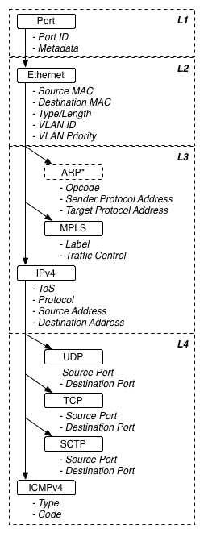
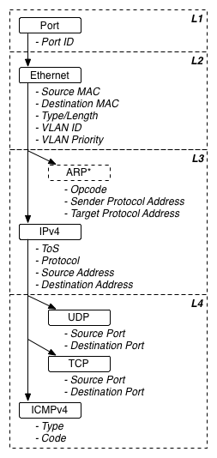
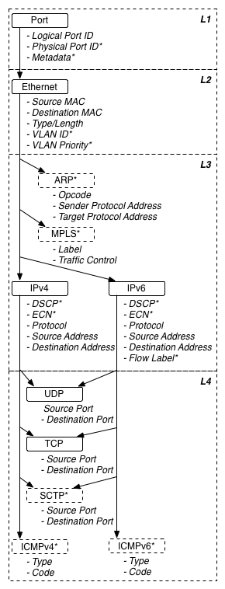
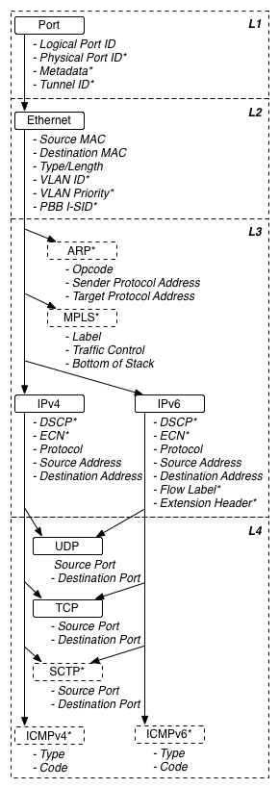
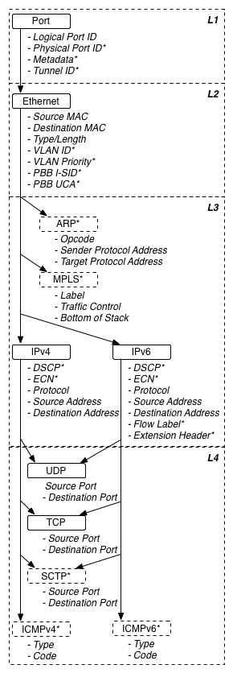
OpenFlow – Match fields
Each version of OF as added support for new fields
OF Version
Release
Match
Depth
Size
OF Version | Release Date | Match fields | Depth | Size
1.0 | Dec 2009 | 12 | 12 | 264
1.1 | Feb 2011 | 15 | 15 | 320
1.2 | Dec 2011 | 36 | 9—18 | 603
1.3 | Jun 2012 | 40 | 9—22 | 701
1.4 | Oct 2013 | 41 | 9—23 | 709
1.5 | Dec 2014 | 44 | 10—26 | 773
Date
fields
1.0
Dec 2009
12
12
264
1.1
Feb 2011
15
15
320
1.2
Dec 2011
36
9
—
18
603
1.3
Jun 2012
40
9
—
22
701
1.4
Oct 2013
41
9
—
23
709
1.5
Dec 2014
44
10
—
26
773
Source of the diagrams: Flowgrammable.org

Slide 4
OpenFlow - Limited Matching
Releasing new specifications for every new protocol is not scalable
What about : GRE, VXLAN, STT, OTV …
Vendor specific protocols
Research protocols ? (“Enabling Innovation in Campus Networks”)
Unable to do inequality or range matching
Linux system ports, 2048 flow entries
Not from physical port, need N-1 flow entries
IPs range 10.0.0.1 and 10.0.0.100, 100 flow entries
What about Time-To-Live (TTL) ?
Forward everything to the controller
Custom OpenFlow match field

Slide 5
Protocol Independent Instruction Set
Do not try to support every existing protocol header fields:
Provide an instruction set suitable to match arbitrary protocols and fields
Execution of the instruction set is an implementation detail
Interpreter, Just-in-time compiler, FPGAs, ASICS, NPU, Intel FlexPipe …
1992 Berkeley Packet Filter (BPF) — McCane and Jacobson:
Designed for packet matching
Platform independent bytecode
Widely used by the Linux kernel
Used by TCPdump, Wireshark, libpcap, winpcap …
Extended BPF (eBPF) + JIT added in Linux kernel 3.18

Slide 6
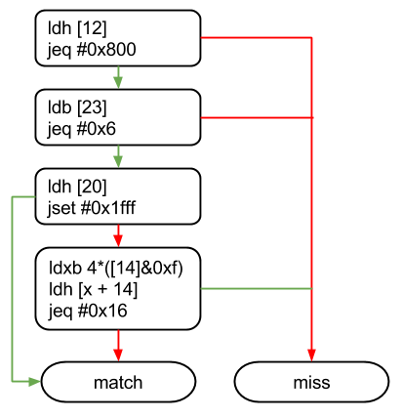
BPF Example
BPF
instructions
Acyclic Control Flow Graph (CFG) representation of the BPF program

Slide 7
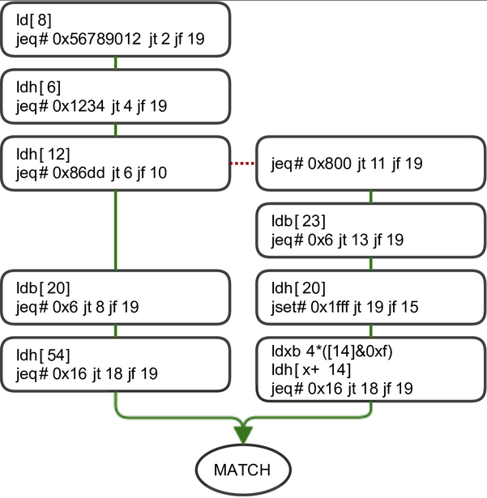
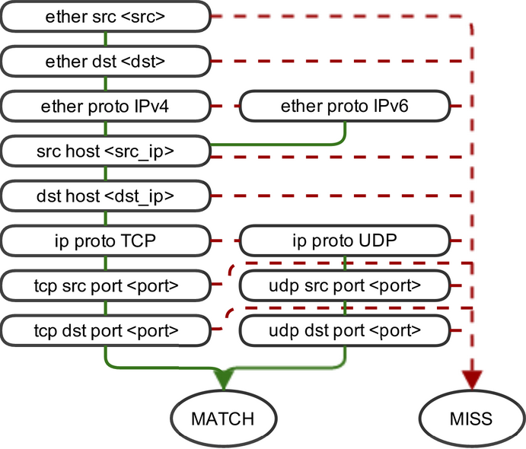
From OpenFlow Match to CFG
Benefits of an Acyclic CFG
One parse per layer
One memory access per layer to be parsed
Execute in the order of the layers
Execute instruction as the packet is received
No backward jumps
No loops (not Turing complete)
Can calculate execution time at compile time (real-time constraints)
Transform OpenFlow Match Fields to a CFG:
Implement OpenFlow match using BPF
Each field is compared using Load + Compare operations
Easily compiled to BPF bytecode

Slide 8
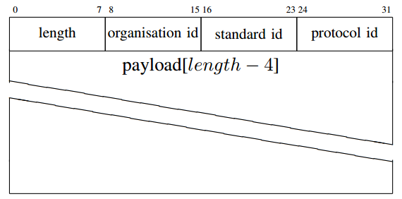
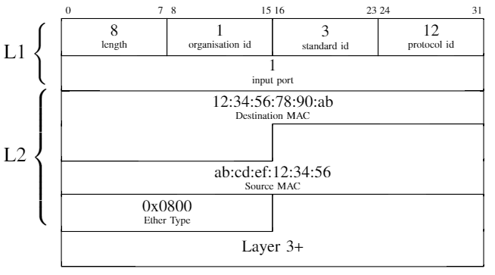
BPF limitations
However BPF designed to be attached to a socket
Must support Layer 1 physical port matching
Could just add input port instruction, not flexible
OpenFlow only support Ethernet (what about the rest?)
L2+ protocols have a wire format, what about L1 ?
Ethernet, WiFi, CAN, 802.15.7 (VLC)
Need to define a structure for L1 protocols that can be used with BPF
Notes:
Protocol 12 = 802.3ab (1Gbit Ethernet)

Slide 9
Implementation
OpenFlow 1.2 added OpenFlow Extended Match fields (OXM)
Allow new match fields to be added to OpenFlow
Still necessary to modify switch and controller to do the matching
Define an OXM to install BPF bytecode
Payload is the byte code that can be directly executed
Modified Ofsoftswitch 1.3, OpenFlow Software Switch
Added OpenFlow OXM to insert BPF Program in flow table
Modified Ryu OpenFlow controller to send the BPF bytecode
Modified the datapath to execute the program (libpcap engine)

Slide 10
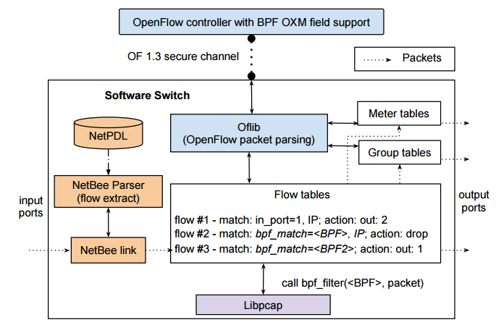
Software Switch

Slide 11
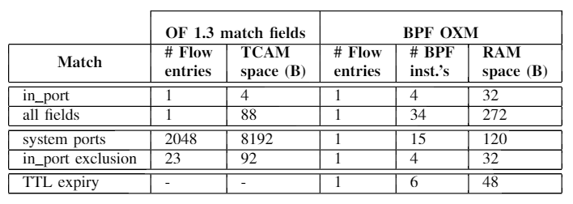
Comparing match scenarios

Slide 12
Consequences
Arbitrary matching
Can match on any protocol
Do not impose particular implementation
Top-of-Rack switches ~2000 flow entries
Already small for complex controllers
Range and inequality matching can quickly overflow the tables
BPF use more memory
Need to store instruction opcode and operands
No need for ternary memory, high-speed RAM (SRAM) instead of TCAM
SRAM, cheaper, denser and less power hungry than TCAM

Slide 13
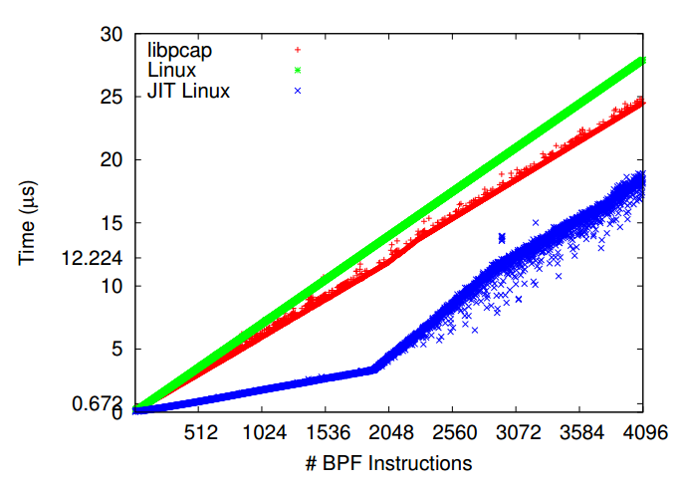
Performance
Comparing:
Linux JIT compiler
Linux interpreter
libpcap interpreter
1Gbps classification:
Min: 0.682μs, 108 instructions
Max: 12.224μs, 2090 instructions
As a ref. can match all OF fields using 34 BPF instructions

Slide 14
Conclusion
OpenFlow won’t work if field matching is not changed
Wildcard or exact match, no range, no inequality
Very limited L1 matching,
Limited protocol support
We propose to use a platform and protocol independent instruction set
Berkeley Packet Filters (BPF) ?
Match at L1+
CFG for operation ordering and real-time constraints
Implementation on ofsoftswitch switch and support in Ryu controller

Slide 15
Thank you!
(code is on github, links in the paper)

Slide 16
P4 ? (sigcomm 2014)
Declarative language for packet processing
Similar idea different approach
Each target platform needs a language compiler
No well-defined control plane protocol (thrift RPC in BM)
Highly focussed on match table mechanism (OpenFlow like)
exact, ternary, lpm, range, valid
What about inequality ?
Compile P4 to BPF ?
Abstract language to bytecode
(we released our code before them)

